Slide 1
Team Members
Tamanna Akter(221-15-5298)
Rabeya Islam Nupur (221-15-5576)
Mehezabin Nawer(221-15-4688)
Fariha Mostafa Nishat (221-15-4873)

Slide 2
Greedy Aprooch Algorithm
By team Lumix

Slide 3
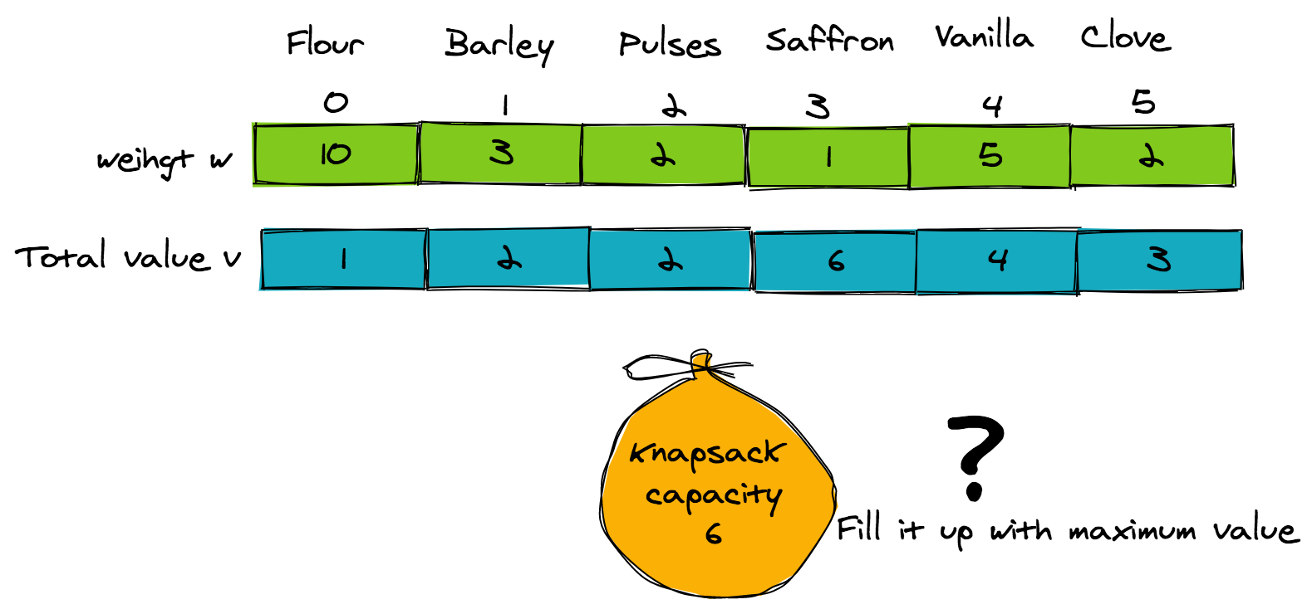
Introduction
Greedy algorithms make choices that seem best at each step, ultimately leading to optimal solutions for a wide range of real-world problems.

Slide 4
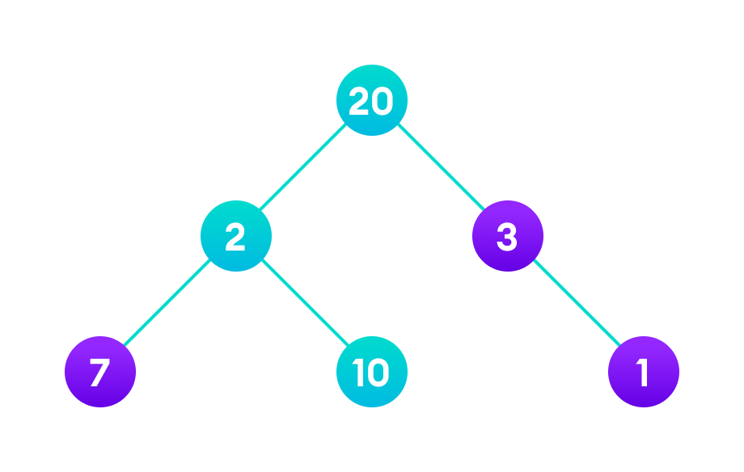
What is Greedy Approach?
Greedy approach is a simple and intuitive algorithmic strategy that involves making locally optimal choices at each step in order to find a global optimum.

Slide 5
Examples of Greedy Approach
Problem Statement: Find the best route to reach the destination city from the given starting point using a greedy method.
The animation given below explains how paths will be picked up in order to reach the destination city.

Slide 6
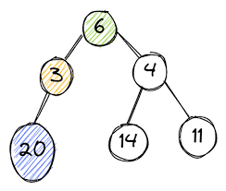
Advantages of Greedy Approach
Simplicity
Efficiency
Applicability
4. Space Efficiency
5. Quick Solutions

Slide 7
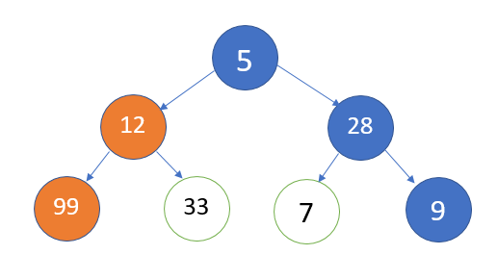
Disadvantages of Greedy Approach
Lack of Optimality
Sensitivity to Input
No Backtracking.
Complex Analysis.

Slide 8
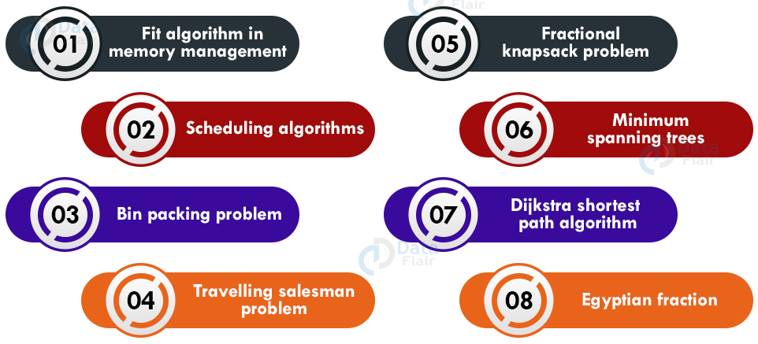
When to Use Greedy Approach

Slide 9
Comparison with Other Algorithms

Slide 10
Challenges in Implementing Greedy Approach
Factors listed below are the limitations of a greedy algorithm:
The greedy algorithm makes judgments based on the information at each iteration without considering the broader problem; hence it does not produce the best answer for every problem.
The problematic part for a greedy algorithm is analyzing its accuracy. Even with the proper solution, it is difficult to demonstrate why it is accurate.
Optimization problems (Dijkstra’s Algorithm) with negative graph edges cannot be solved using a greedy algorithm.

Slide 11
Conclusion
Greedy Algorithms offer a powerful and elegant approach to problem-solving in computer science. Their simplicity, efficiency, and versatility make them valuable tools in tackling various real-world challenges. While they excel in many scenarios, it's crucial to acknowledge their limitations and ensure careful analysis. As we've seen, mastering the art of Greedy Algorithms can open doors to optimizing solutions and finding the 'best next step' in a wide range of applications.

Slide 12
Thanks!

